Slide 1


Slide 2

30 Days Python Master Class
Day1 : Python
Time: 6.00 PM IST
Free Registration

Slide 3
Python Master Class
Handbook

Slide 4
NANDHINI.S
Exp: 5 Yrs
Expert in
Python Developer on Machine Learning
Deep learning with computer vision
Matlab – Image Processing
Autonomous Car design using ROS with LIDAR
Language – Python , Java , HTML ,CSS.
Tools – ANACONDA NAVIGATOR, JUPYTER NOTEBOOK,
GOOGLE COLAB.
Graduation : BE – ECE | 2011

Slide 5
Pantech?
Educational Equipment Manufacturer
IoT, AI, Robotics,Autonomous Robot
Microprocessor/Microcontroller
DSP,VLSI, Embedded System
Power Electronics & Drives, Fuel Cell Trainer Kit
Renewable Energy Lab, Electric Vehicle Lab
Technical Training
DIY Project

Slide 6

What is Master Class ?
👍 This is the 30 Days Industrial Learning Activity.
👍 Its Online YouTube Live Class
👍 If you Invest 45 minutes daily, U will become Master in Data Science
👍 You will get FREE E-Certificate
Webinar Participation Certificate
“Learning is the beginning of wealth.
Searching & Learning is where the miracle process all begins.” …………….Jim Rohn

Slide 7
Our Vision
Help 10 Million Students to Learn the Technology in Easy Way

Slide 8

Associate Partner for this Master Class
https://apssdc.in/home/

Slide 9
What U will Learn from 30 Days Data Science & Analytics Master Class

Slide 10





Python Learning Plan
01
02
03
04
05
Library
Python
Analytics
Analytics
Industry Project
Introduction To Python and Python Data Structures
Pandas
Numpy
MatplotLib
Cborn, SKLearn Lib
Collab
Distribution
Visualization
Aggregation
Statistics
Distribution Function
Project Building

Slide 11
Day wise Learning Plan
Day -1 : Introduction to Python
Day -2: Python – Tools|Syntaxes & Data Structures
Day -3: Python – Dictionaries,Date and Time
Day -4: Python – MySql
Day -5: Pandas library – Introduction
Day -6: Pandas library – Data Structures
Day -7: Numpy library – Introduction
Day -8: Numpy library – Array Manipulations, Mathematical Functions
Day -9: Matplotlib , Histogram Using Matplotlib | I/O With Numpy
Day -10: Matplotlib Library - Introduction , Pyplot API | Types Of Plots
Day -11: Seaborn Library
Day -12: SKLearn Library
Day -13: Python – Date and Time , Data Wrangling.
Day -14: Python – Data Cleansing
Day -15: Python – Word Tokenization , Stemming and Lammetization.

Slide 12
Day wise Learning Plan
Day -16: Python – Data Visualization
Day -17: Python – Statistical Analysis
Day -18: Python – Types Of Distribution
Day -19: Python – Correlation ,Chi-Square Test , Linear Regression
Day -20: Keras library – Introduction.
Day -21: Stock Price Prediction With Machine Learning LSTM RNN
Day -22: People’s behaviour in chat message using NLP NLP
Day -23: Gaming In Python
Day -24: Chatbot creation in Python NLP
Day -25: Electricity Price Prediction Using ML Random Forest Regressor
Day -26: Diamond Price Prediction Using Python Linear Regression
Day -27: Book Recommendation System KNN
Day -28: Image Classification Using CNN CNN
Day -29: Titanic Survival Analysis Using ML Logistic Regression
Day -30: Blockchain in Python

Slide 13
List of Projects for Demo in YouTube Live
Stock Price Prediction With Machine Learning
People’s behaviour in chat message using NLP
Gaming In Python
Chatbot creation in Python
Electricity Price Prediction Using ML
Diamond Price Prediction Using Python
Book Recommendation System
Image Classification Using CNN
Titanic Survival Analysis Using ML
Blockchain in Python
All Projects in Jupyter Notebook

Slide 14
What you will get from this Free 30 Days Master Class?
You can attend YouTube Live Class
Free E-Certificate ( WEBINAR PARTICIPATION CERTIFICATE)

Slide 15
How to mark your Attendance in YouTube Live Class?
Ans : During the Live Class, organizer will post Google Form link in Live Chat. The Participants should submit the from on daily basis. Minimum 25 Days Attendance is Required to get Free Master Class Participation Certificate.
Note : The Link will be available during the Live. From the LIVE Class date, the live video will get removed from the YouTube in 3 days.

Slide 16
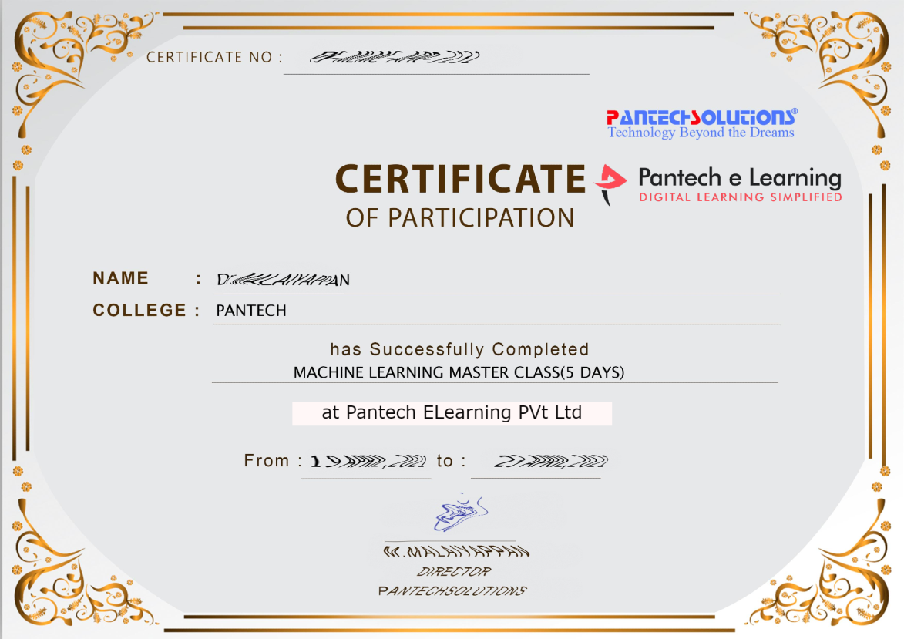

Sample Webinar Participation Certificate?

Slide 17
https://www.pantechelearning.com/data-science-master-class/
On Demand
You can get chance to apply 1 Month Internship on Data Science & Analytics Master Class

Slide 18
What is Internship????
Learn
Practice
Verify
Get Certified
Grow

Slide 19
Free Master Class DSA | 1 Month Internship on DSA
Master Class Participation Certificate | Internship Completion Certificate
Minimum 25 Class should attend YouTube Live | Recorded Class Link will be provided. – LMS Portal Access
YouTube Live Mandatory | Your Choice. You can attend Live or else You can watch Recorded Class in LMS Portal
All Projects Demo class in YouTube Live | Step by Step Video Explanation Content in LMS Portal
Access : 3 Days | VIP WhatsApp Group Support
 | You Can Download All PPTs
 | 4 Nos of Hackathon Class in Zoom Live. The Recording also will be provided
 | You Can Download All Project Files
 | Mentor will guide you to finish 10 Projects
 | Access : 60 Days

Slide 20
Pantech will make you to Create 10 Projects in Data Science & Analytics in 30 Days
Objective of this 30 Days Master Class

Slide 21
1 Month Internship in Data Science
INTERNSHIP E-Certificate(30Days Internship on Data Science Engineering)
Highly organized Video content
Download All Files
Download PPTs
Assignments
Flexible Time.
Access Period: 60Days from the date of payment

Slide 22
What You Will Get???
Complete Project Files
30 Days Learning Activity
Data Science Core Concepts
10 + Projects
Project PPT
Spatial Data Science For Covid-19 Disease Prediction
Parkinson’s Disease Prediction-XGBoost Classifier
House Price Prediction-Random Forest Regression
Customer Segmentation Using ML-K-Means Clustering
Home Loan Prediction-Decision Tree Classifier
Spam Classification-NLP
Hand Written Digit Recognition Using Python-CNN
Churn Prediction-Deep Learning
Crop Yield Prediction
Ground water level prediction
Video Class Access for 2 Months
Get chance to Enroll 1-Month Internship on demand

Slide 23
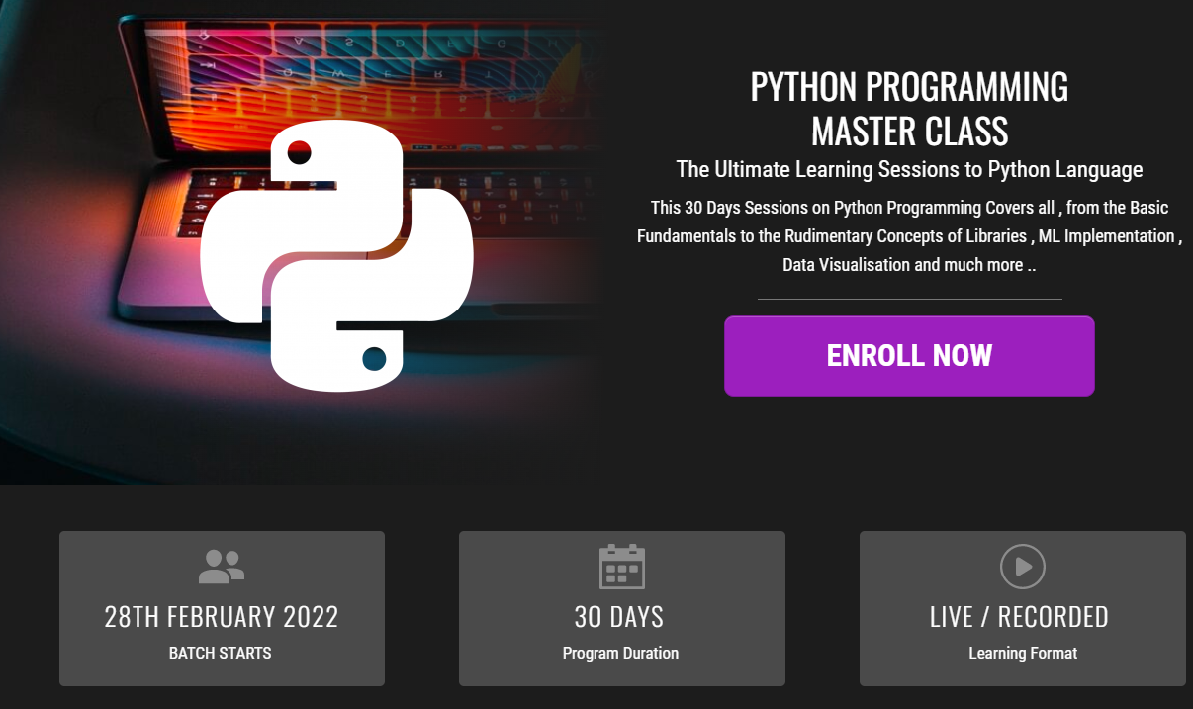
How to join in 1 month Internship
https://www.pantechelearning.com/pymc-internship/
Coupon Code: PYMC

Slide 24
LOGISTIC REGRESSION

Slide 25
LOGISTIC REGRESSION
It is a supervised learning algorithm used to predict the probability of target variable.
The nature of target variable is dichotomous
It means that there would be only two possible classes.
The dependent variable is binary in nature having data coded as 1(stands for success) and 0(stands for failure)
A logistic regression model predicts P(Y = 1) as a function of X.
It is one of the simplest algorithms that can be used for various classification problems.
The classification problems can be spam detection, diabetes prediction and cancer detection.

Slide 26
TYPES OF LOGISTIC REGRESSION:
Logistic regression means binary logistic regression having two target variables.
There can be two more categories of target variables that can be predicted by it.
Based on the number of categories , logistic regression can be classified into the following types:
Binary or Binomial: In this , a dependent variable will have only two possible types , 1 and 0.
These variables may represent success or failure, yes or no , win or loss.

Slide 27
TYPES OF LOGISTIC REGRESSION:
Multinomial: In this kind of classification , dependent variables can have three or more possible unordered types.
These types have no quantitative significance.
These variables may represent “Type A” or “Type B” or “Type C”.

Slide 28
TYPES OF LOGISTIC REGRESSION:
Ordinal: In this kind of classification , dependent variable can have three or more possible ordered types.
All these types have a quantitative significance.
These variables may represent “poor” or “good” ,”very good” and “excellent”.
Each category can have the scores like 0,1,2,3.

Slide 29
LOGISTIC REGRESSION ASSUMPTIONS:
Before implementing logistic regression, the following assumptions should be considered.
In case of binary logistic regression , the target variables must always be binary.
The desired outcome is denoted by the factor level 1.
There should not be any multi-collinearity in the model.
The independent variables must be independent of each other.
Meaningful variables must be included in the model.
A large sample size should be chosen for logistic regression.

Slide 30
BINARY LOGISTIC REGRESSION MODEL:
The simplest form of logistic regression is the binary logistic regression.
The target variable can have two positive types 1 or 0.
It allow us to model a relationship between multiple predictor variable and a binary target variable.
The linear function is used as an input to another function g in the following relation
hθ(x)=g(θTx)where0≤hθ≤1

Slide 31
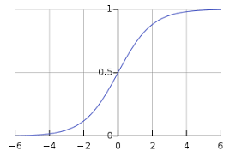
BINARY LOGISTIC REGRESSION MODEL:
Here , g is the logistic or sigmoid function . It can be given as follows:
g(z)=11+e−z where z = θTx
The sigmoid curve can be represented in the form of graph:

Slide 32
BINARY LOGISTIC REGRESSION MODEL:
The value of y-axis lie between 0 and 1 and crosses the axis at 0.5.
The classes can be divided into positive or negative.
The output comes under positive class if it lies between 0 and 1.
We are interpreting the output of hypothesis function as positive if it is >=0.5,else negative.
We need to define a loss function to define how well the algorithm performs using the weights on function.

Slide 33
BINARY LOGISTIC REGRESSION MODEL:
ℎ=𝑔(𝑋𝜃)
J(θ)=1/m.(−yTlog(h)−(1−y)Tlog(1−h))
After defining the loss function , our primary goal is to minimize the loss function.
It can be done with the help of fitting the weights by increasing or decreasing the weights.
With the help of derivatives of loss function with respect to each weight , we should know which parameters should have high weight and which should have low weight.

Slide 34
BINARY LOGISTIC REGRESSION MODEL:
The following gradient descent equations tell how loss would change if we modified the parameters:
δJ(θ)/δθj=1/mXT(g(Xθ)−y)

Slide 35
EXAMPLE:
We have a Data set having 5 columns namely: User ID, Gender, Age, EstimatedSalary and Purchased
Now we have to build a model that can predict whether on the given parameter a person will buy a car or not.

Slide 36
Steps to build a model
Importing the libraries Here we’ll import libraries which will be needed to build the model.
import numpy as np
import matplotlib.pyplot as plt
import pandas as pd

Slide 37
2. Importing the Data set
We’ll import our Data set in a variable (i.e dataset) using pandas.
path = r"D:\Social_Network_Ads.csv"
dataset = pd.read_csv(path)

Slide 38
3. Splitting our Data set in Dependent and Independent variables.
In our Data set we’ll consider Age and EstimatedSalary as Independent variable and Purchased as Dependent Variable.
X = dataset.iloc[:, [2,3]].values
y = dataset.iloc[:, 4].values
Here X is Independent variable and y is Dependent variable.

Slide 39
3. Splitting the Data set into the Training Set and Test Set
Now we’ll split our Data set into Training Data and Test Data. Training data will be used to train our Logistic model and Test data will be used to validate our model
We’ll use Sklearn to split our data. We’ll import train_test_split from sklearn.model_selection
from sklearn.model_selection import train_test_split X_train, X_test, y_train, y_test = train_test_split(X, y, test_size = 0.25, random_state = 0)

Slide 40
4. Feature Scaling
Now we’ll do feature scaling to scale our data between 0 and 1 to get better accuracy.
Here Scaling is important because there is a huge difference between Age and EstimatedSalay.
Import StandardScaler from sklearn.preprocessing
Then make an instance sc_X of the object StandardScaler
Then fit and transform X_train and transform X_test

Slide 41
4. Feature Scaling
from sklearn.preprocessing import StandardScaler sc_
from sklearn import preprocessing
X = StandardScaler()
X_train = sc_X.fit_transform(X_train)
X_test = sc_X.transform(X_test)

Slide 42
5. Fitting Logistic Regression to the Training Set
we’ll build our classifier (Logistic).
Import LogisticRegression from sklearn.linear_model
Make an instance classifier of the object LogisticRegression and give random_state = 0 to get the same result every time.
Now use this classifier to fit X_train and y_train

Slide 43
5. Fitting Logistic Regression to the Training Set
from sklearn.linear_model import LogisticRegression
classifier =LogisticRegression(random_state=0) classifier.fit(X_train, y_train)

Slide 44
5. Fitting Logistic Regression to the Training Set
Now use the classifier to make the prediction for the Test Data set and find the accuracy using Confusion matrix.
y_pred = classifier.predict(X_test) print(y_pred )

Slide 45
7. Making the Confusion Matrix
Now we can use y_test (Actual Result) and y_pred ( Predicted Result) to get the accuracy of our model.
Using Confusion matrix we can get accuracy of our model.
from sklearn.metrics importconfusion_matrix cm = confusion_matrix(y_test, y_pred) print(cm)

Slide 46
Use cm to calculate accuracy as shown below:
Accuracy = ( cm[0][0] + cm[1][1] ) / ( Total test data points )
(65 + 24) / 100
0.89

Slide 47
MULTINOMIAL LOGISTIC REGRESSION MODEL:
Another form of logistic regression is the multinomial logistic regression.
The target variable can have three possible unordered types.
The types have no quantitaive significance.

Slide 48
IMPLEMENTATION IN PYTHON:
We are going to implement the above concept of multinomial logistic regression in python.
We are using a dataset from sklearn named digit.
Import sklearn
from sklearn import datasets
from sklearn import linear_model
from sklearn import metrics
from sklearn.metrics import accuracy_score
from sklearn.model_selection import train_test_split

Slide 49
IMPLEMENTATION IN PYTHON:
Next , we need to load the digit dataset
digits = datasets.load_digits()
Define the feature matrix(X) and response vector(y)
X = digits.data
y = digits.target
We are going to split X and y into training and testing sets.
X_train, X_test, y_train, y_test = train_test_split(X, y, test_size=0.4, random_state=1)

Slide 50
IMPLEMENTATION IN PYTHON:
We create an object of logistic regression
digreg = linear_model.LogisticRegression()
Next,we need to train the model using the training sets.
digreg.fit(X_train, y_train)
Make predictions on the testing set as follows
y_pred = digreg.predict(X_test)

Slide 51
IMPLEMENTATION IN PYTHON:
Next , print the accuracy of the model as follows:
print("Accuracy of Logistic Regression model is:",
print("Accuracy Score:" , accuracy_score(y_test,y_pred))

Slide 52
Output:
Accuracy of Logistic Regression model is: 95.6884561891516

Slide 53
DOUBTS:

Slide 54


